Slide 1

Project manager
Rupak Rawal
Samir Shrestha
Utsav Maharjan

Slide 2

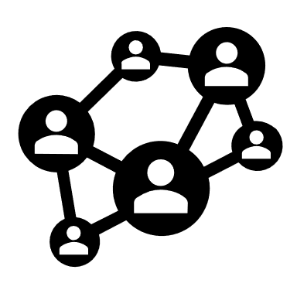



Contents
Introduction
Objective
features
Importance
Figures
Gantt Chart
Conclusion
Apprendix
​

Slide 3

Introduction
It is a web-based platform that is useful to students and project managers for the management, tracking and supervision of projects.

Slide 4

Objectives
To track activities of projects.
To develop efficient communication and productive guidelines.

Slide 5



FEATURES
Task
Management
progress
Monitoring
Profile
management
Users can manage events and tasks
Supervisor can monitor the project progress
User can manage the profile details

Slide 6
Importance
Efficient
monitoring
Efficient
evaluation
Proper structure is to be followed to complete the project
Ensures to do right things at the right time through out project life cycle

Slide 7
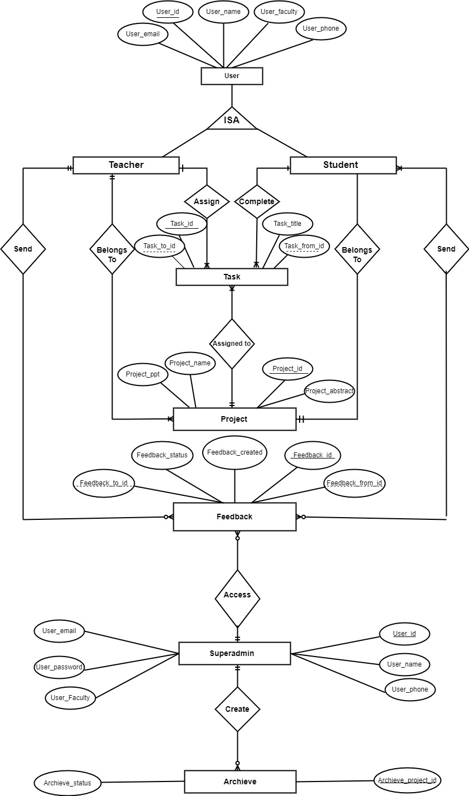
Entity relation diagram

Slide 8
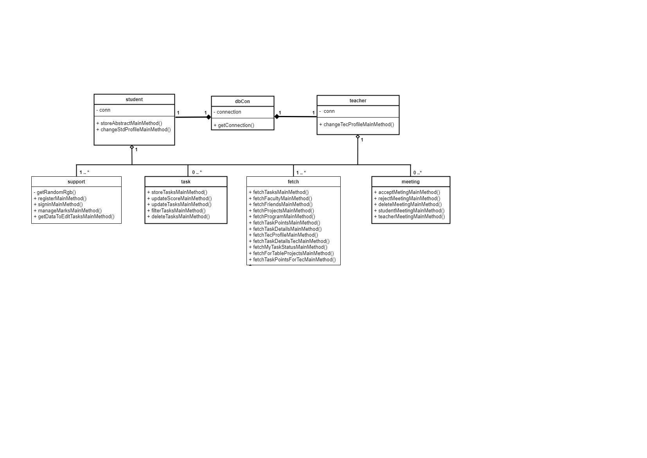
Class Diagram

Slide 9
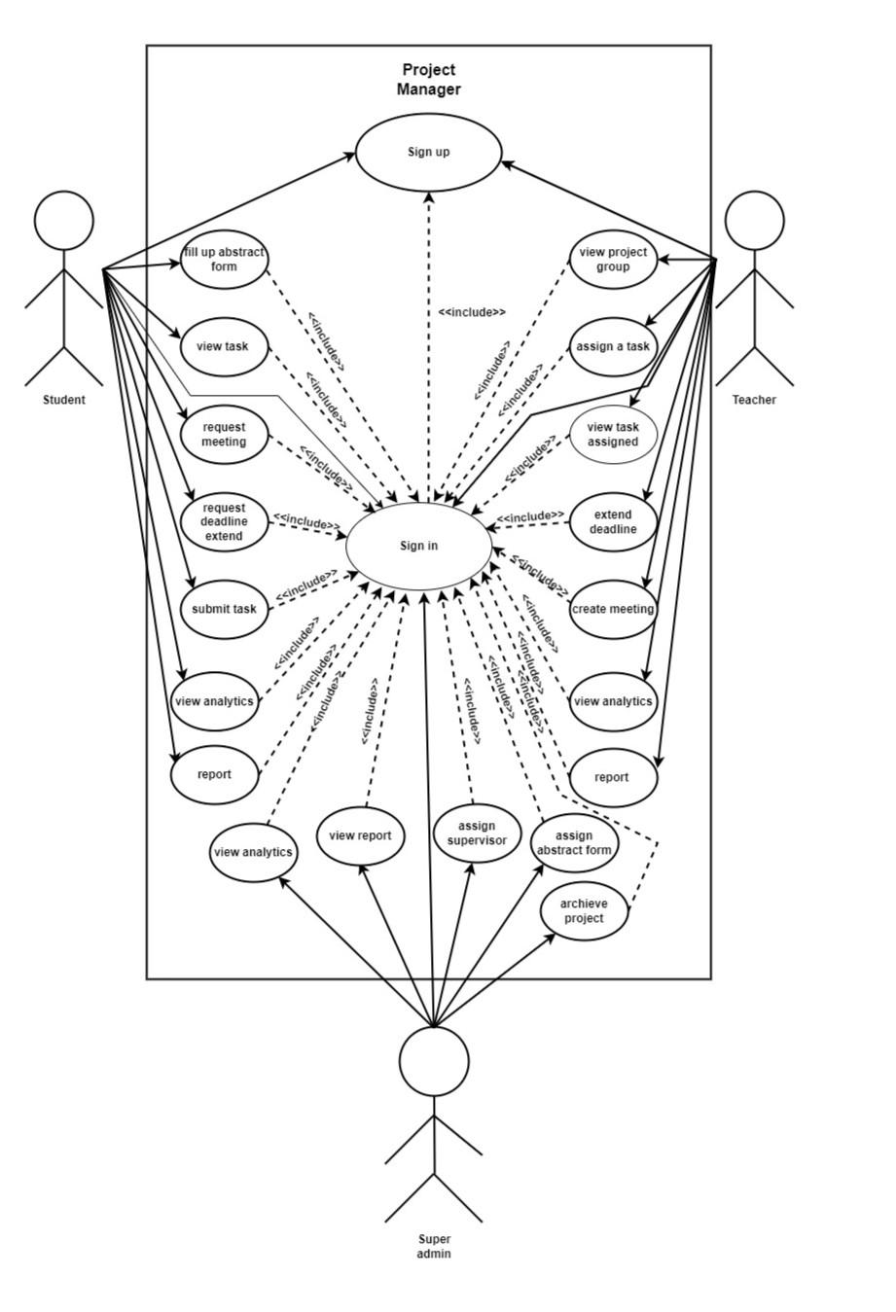
Use case diagram

Slide 10
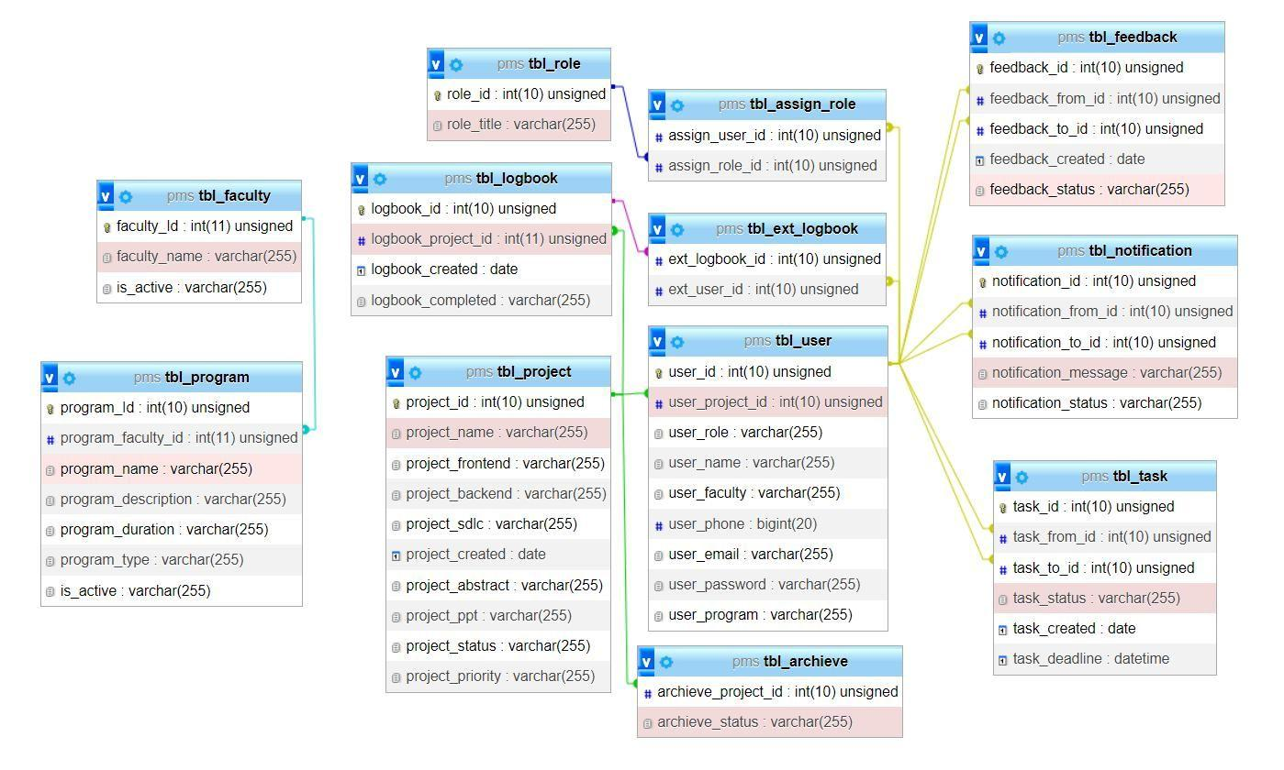
Relational data structure

Slide 11
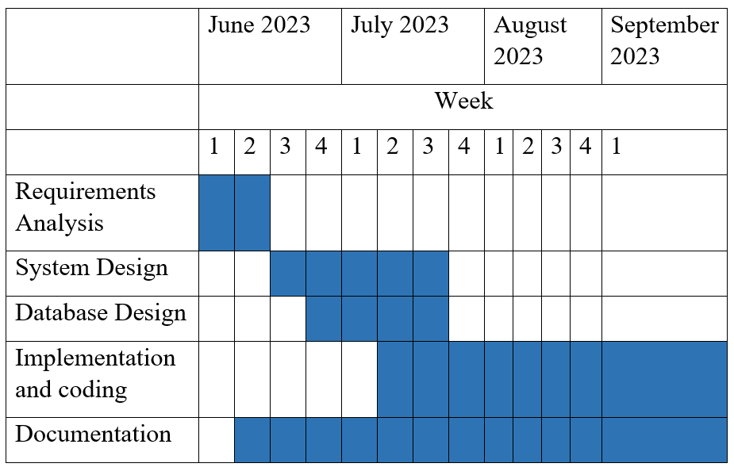
Gantt chart

Slide 12
Summary
The main goal of this project is to build an integrated website to handle project activities.
Deadline 1
Deadline 2
Deadline 3

Slide 13
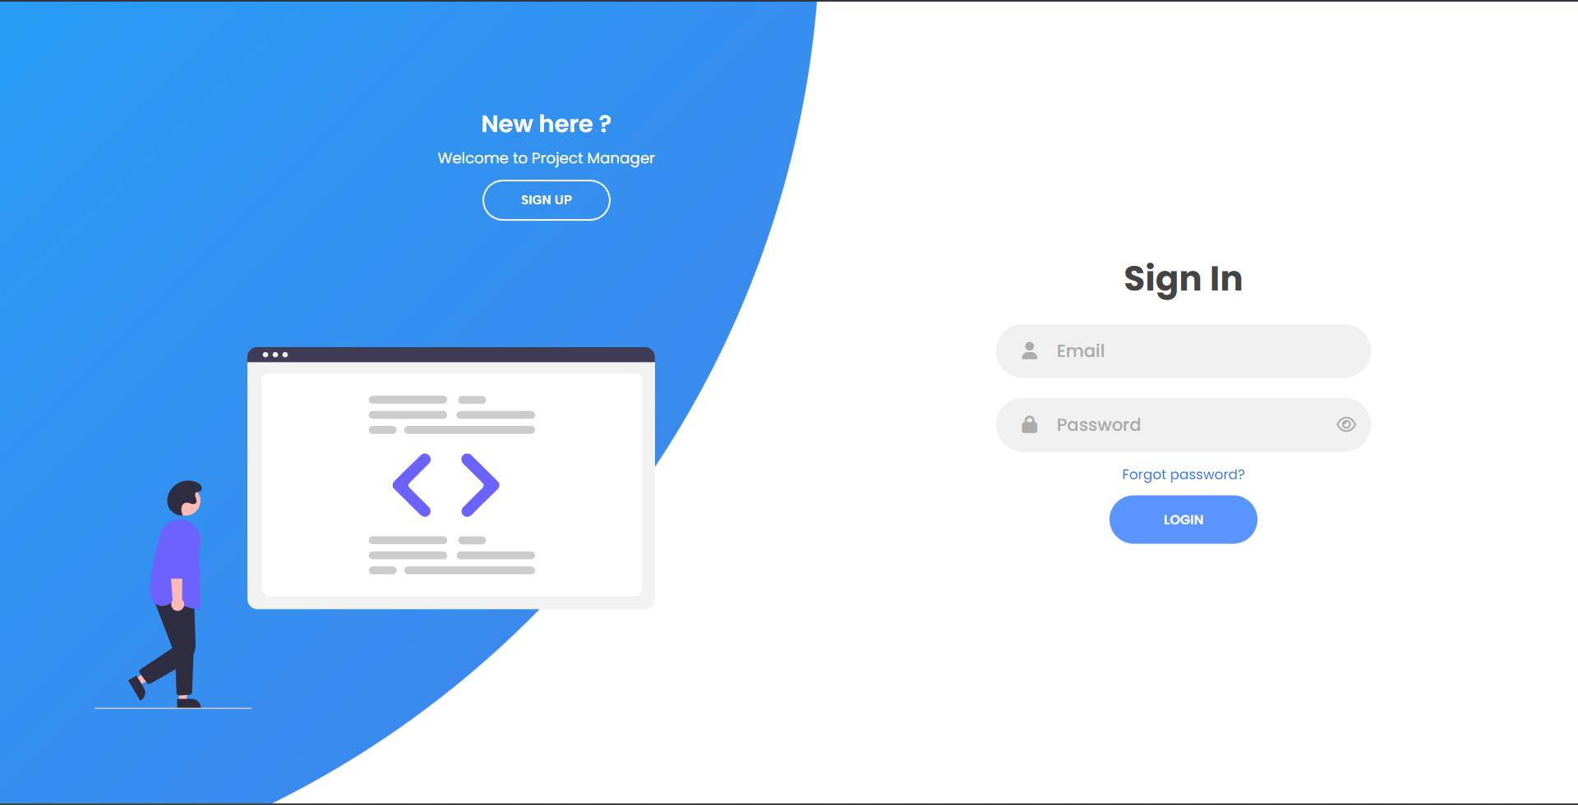
appendix

Slide 14
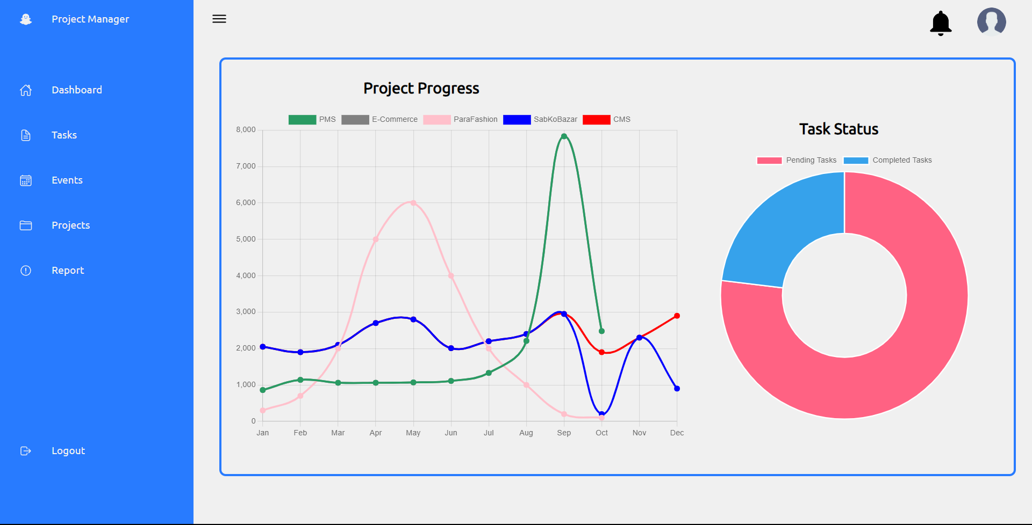

Slide 15
Project
manager
Thank you

Slide 16



Contents
Introduction
Objectives
Features
Importance
​
18/05/2080

